Slide 1

EDUCATIONAL TRAVELING Projects

Slide 2
CONTENTS
01
02
TEAM MEMBERS
TOPIC
03
04
STAGES OF REALIZATION
USED TECHNOLOGY

Slide 3
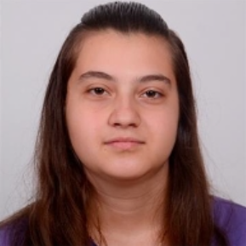
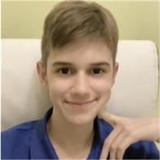
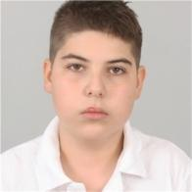
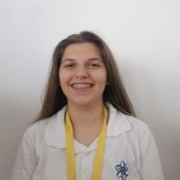
TEAM MEMBERS
Zhasmina Mihaleva
Scrum Trainer
10G
Zafir Stoyanov
Backend Developer
10G
Danail Todorov
Backend Developer
10G
Aleksandra Petrova
QA engineer
10G

Slide 4
Topic
The topic of the project was to create a C++ game or software for a traveler making his way through Europe. The idea is to accumulate points from history and geography questions, learning new information.

Slide 5
STAGES OF REALIZATION
3rd
4th
Idea
Organization
1st
2nd
Realization
Present

Slide 6












USED TECHNOLOGY

Slide 7
LET’S MOVE ON TO OUR PROJECT!

Slide 8
THANKS FOR YOUR ATTENTION!

